Slide 1
Module 7: Lesson 5 NoSQL Database Classifications (Part 2)

Slide 2
Handling Failure Conditions The CAP Theorem
Consistency (C) in NoSQL databases refers to the property ensuring that all nodes in a database return the most recent write for a given data item, maintaining uniformity across all replicas
Availability(A), on the other hand, denotes the ability of a NoSQL database to respond to read and write requests in the presence of node failures or network partitions, ensuring uninterrupted service.
Partition Tolerance (P) refers to the ability of a distributed system to continue to operate even if the network partitions the cluster, isolating some nodes from others
The CAP theorem, proposed by Eric Brewer, posits that for a NoSQL database, it's impossible to simultaneously achieve Consistency (C), Availability (A), and Partition tolerance (P).
That is, Brewer argues that a system can be both available and consistent in normal operation, but in the presence of a network partition, this is not possible

Slide 3
Handling Failure Conditions The CAP Theorem
We assume that all NoSQL databases must function in environments where network partitions are possible, so they must prioritize one of two options
1. To continue processing client requests to preserve availability (AP).
2. To reject client requests in order to uphold consistency guarantees (CP)
The first option violates consistency, because it might lead to stale reads and conflicting writes
While the second option obviously sacrifices availability

Slide 4
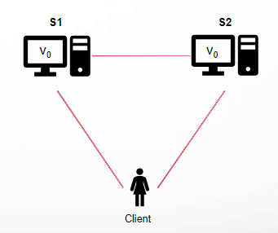
Distributed Database System Model
Let's consider a very simple distributed system
Our system is composed of two servers, S1 and S2
Both servers keep track of the same variable v, with an initial value v₀
S1 and S2 can communicate with each other and can also communicate with our client

Slide 5
Distributed Database System (Strong) Consistency
Any read operation that begins after a write operation completes must return the value just written (or the result of a later write operation)
In a consistent system, once a client writes a value to any server and gets a response, it expects to get that value (or a fresher value) back from any server it reads from.

Slide 6
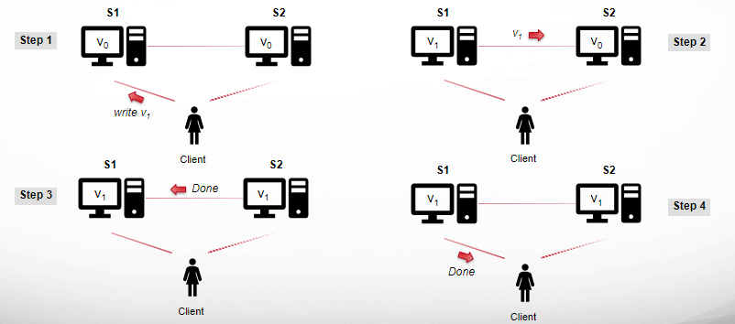
Distributed Database System Example of a Consistent System (Write Phase)

Slide 7
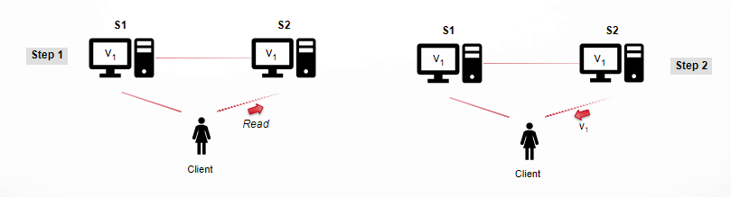
Distributed Database System Example of a Consistent System (Read Phase)
In this system, S1 replicates its value to S2 before sending an acknowledgement to the client that the write is complete
When the client then reads from S2, it gets the most up to date value of v which is v1

Slide 8
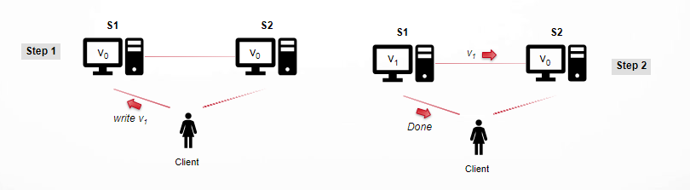
Distributed Database System Example of a Inconsistent System (Write Phase)

Slide 9
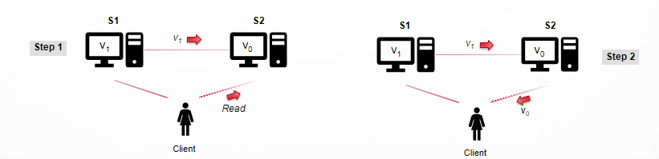
Distributed Database System Example of a Inconsistent System (Read Phase)
Our client writes v1 to S1 and S1 acknowledges, but when it reads from S2 , it may get stale data v0
All replicas of variable v will eventually hold the same
updated value, in our case 1, if given enough time for updates to propagate across a cluster
This is referred to as eventual consistency.

Slide 10
Distributed Database System Availability
Every request received by a non-failing node in the system must result in a response
In an available system, if our client sends a request to a server and the server has not crashed, then the server must eventually respond to the client
The server is not allowed to ignore the client's requests

Slide 11
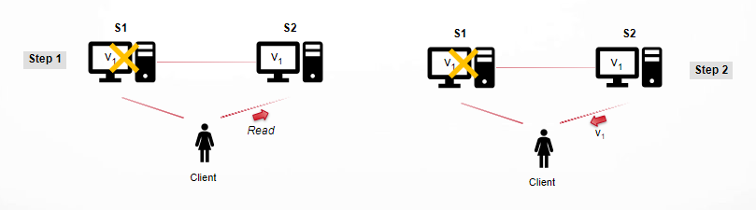
Distributed Database System Example of Availability
Even though S1 has failed, this does not impact the ability of S2 to service requests

Slide 12
Distributed Database System Partition Tolerance
Network Partition
A breakdown in communication between different parts of a distributed system, such as among nodes in a NoSQL database cluster
Under this condition the network can lose arbitrarily many messages sent from one node to another
Partition Tolerance
Within the CAP theorem, network partition tolerance refers to a distributed system's ability to continue operating
And this must be the case even when a partition disrupts communication between different nodes

Slide 13
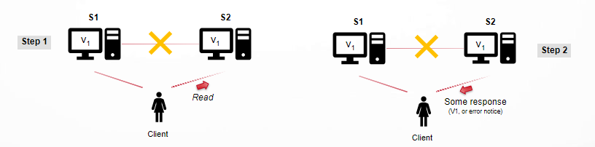
Distributed Database System Example of Partition Tolerance
Even though the connection between S1 and S2 has failed, this does not impact the ability of S1 or S2 to service requests
But the response may be a value for V (either current or stale) or an error notice of some kind, just not silence, or something random

Slide 14
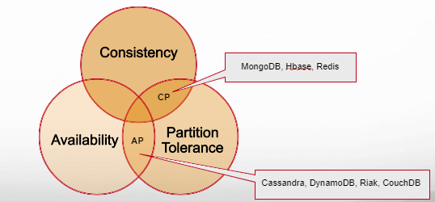
CAP Theorem
In the face of a network partition a distributed database must choose to be either available or consistent, but it cannot choose both

Slide 15
CAP Theorem
The CAP theorem demands you answer this question…
Do I give up strict consistency, or give up ensured availability?
Do we lock out requests until consistency can be enforced across all nodes?
Or do we service requests and accept that data on nodes may be (or become) inconsistent?
Strict
Consistency
Ensured Availability

Slide 16
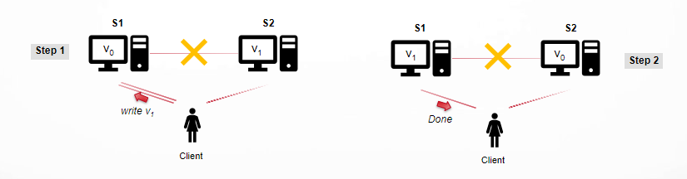
CAP Theorem AP: Available, Partition Tolerant, Not Consistent (Write Phase)
Since our system is available S1 must respond
Since the network is partitioned S1 cannot replicate its data to S2

Slide 17
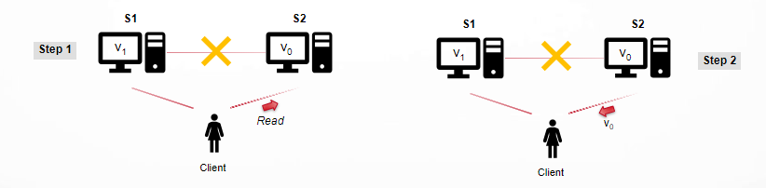
CAP Theorem AP: Available, Partition Tolerant, Not Consistent (Read Phase)
Since our system is available, S2 must respond
And since the network is partitioned, S2 cannot update its value from S1
So a client would obtain different values of V depending on whether it issues a read to S1 or S2

Slide 18
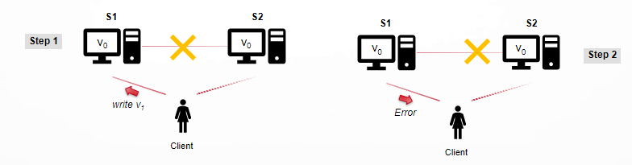
CAP Theorem CP: Consistent, Partition Tolerant, Not Available
Since the network is partitioned S1 cannot replicate its data to S2
To remain consistent the write must be delayed (or fail) until S1 and S2 can communicate

Slide 19
Why this is important?
The future of databases is distributed
The CAP theorem describes some of the tradeoffs involved in distributed systems
A proper understanding of the CAP theorem is essential to making decisions about the future of distributed database design
Misunderstanding can lead to erroneous or inappropriate design choices
NoSQL databases can be categorized as to whether they prioritize availability over consistency or consistency over availability

Slide 20
Why this is important?
NoSQL databases can be categorized as to whether they prioritize availability over consistency or consistency over availability
It's important to note that many modern NoSQL databases offer configurable consistency levels, allowing users to adjust the balance between consistency, availability, and partition tolerance based on specific use cases and requirements
Additionally, the classification of databases into strict AP or CP categories is often oversimplified, as real-world systems often involve trade-offs and nuances not fully captured by the CAP theorem

